Slide 1
TrackEDU
Smart attendance system
Klayden Wong Chen Khai 0372886
Adrian Chan Jun Lim 0372892
Darrel Koh Yao Wen 0371302
Hooi Mun Yew 0372777

Slide 2
Project Background
Problems
Solutions
Time Inefficiency – Paper and pen method takes a long time
Human Error – Misreading names, incorrect marking and data entry errors
Proxy Attendance – Traditional method can't reliably verify if student physically attended class
Passive RFID student ID cards
Arduino microcontroller with a RFID reader module
A secure web-based dashboard which can be used for real time attendance management and visualization

Slide 3
Content
Target Users
Core Features
Teachers – Marks daily attendance
Administrators – Monitor attendance patterns and generate reports
Students – Attends class and makes sure attendance via app is taken
Secure Authentication – Staff login with login credentials
Manual Attendance Taking – Override and correct attendance status
Real Time Feedback – Notifications confirm attendance recording
Attendance Report – Filterable report view by date, class, student

Slide 4
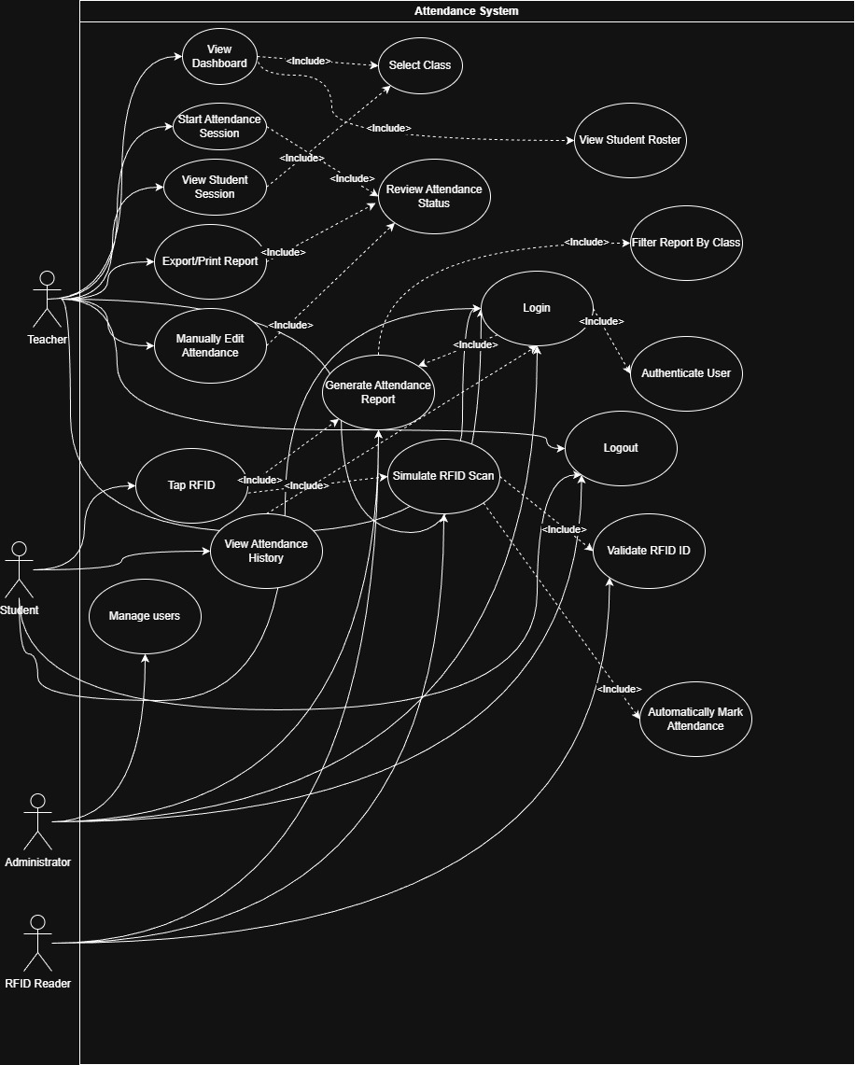
Use Case Diagram

Slide 5
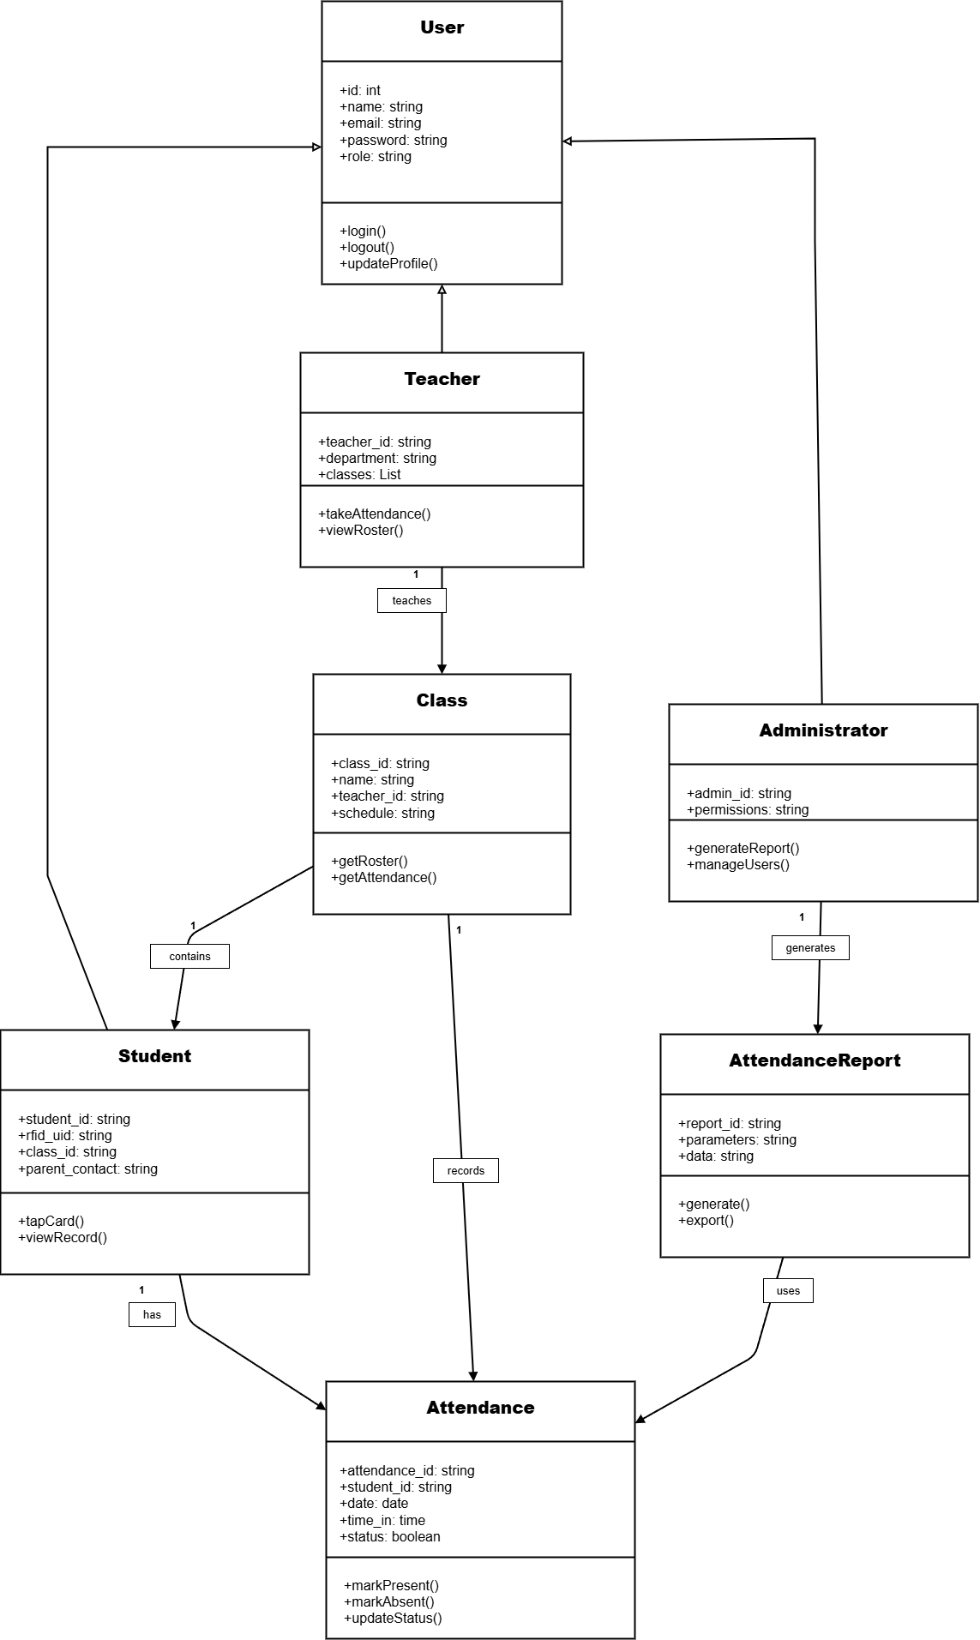
Class Diagram
Models the static structure of the TrackEDU, showing its classes, attributes, methods, and relationships
Main Classes:
User – Handles login, logout, and profile management.
Teacher – Responsible for taking attendance and viewing class rosters
Class – Contains the student roster and attendance records
Student –Represents students who tap their RFID cards to record attendance
Administrator –Manages users and generates attendance reports
Attendance – Stores attendance information
Attendance Report - Generates and exports attendance reports

Slide 6
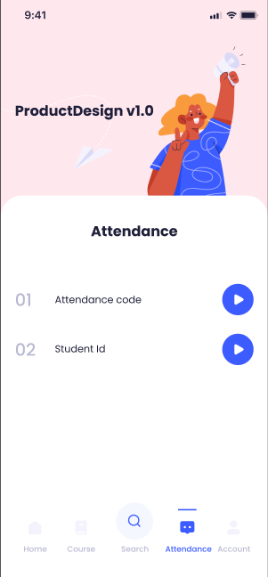
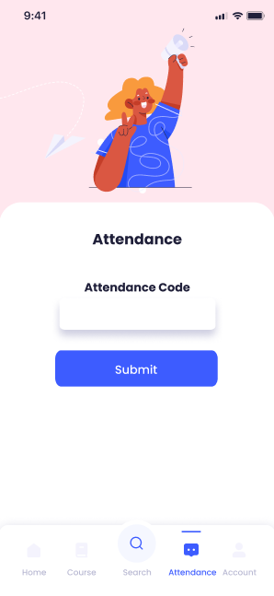
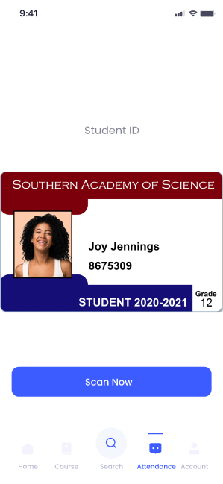
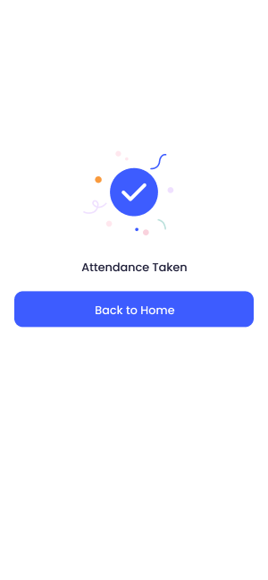
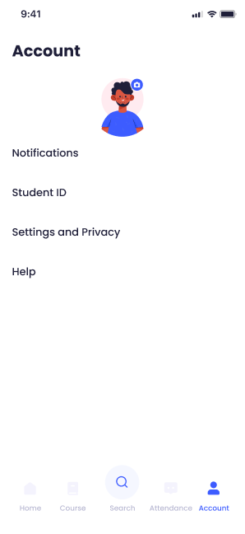
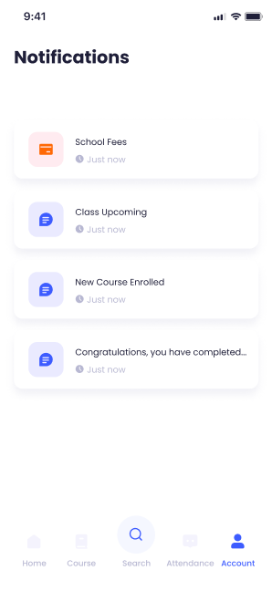
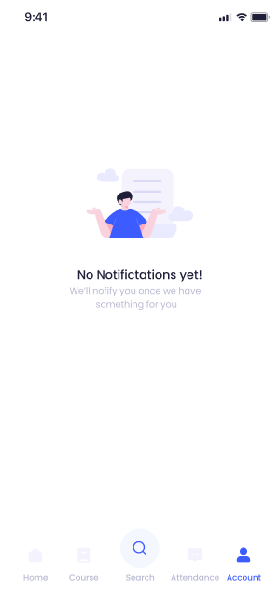
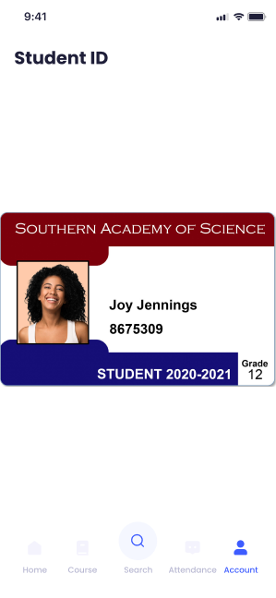
Storyboard/ prototype

Slide 7
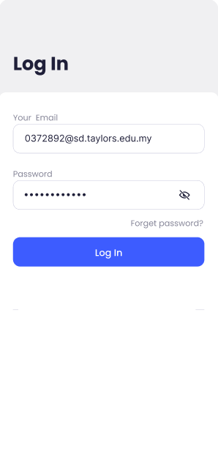
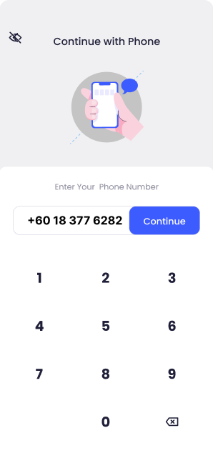
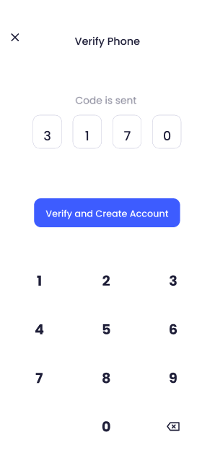
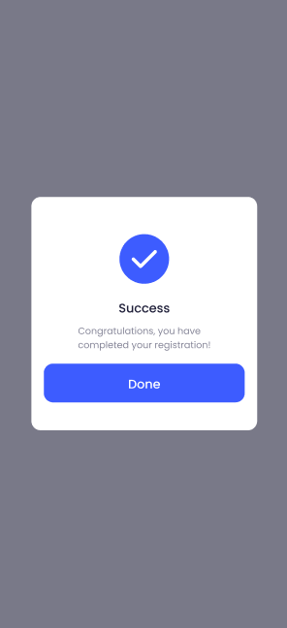
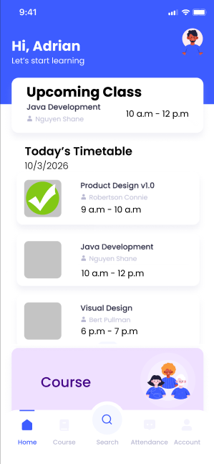
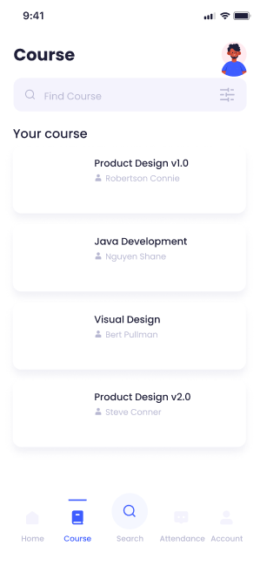
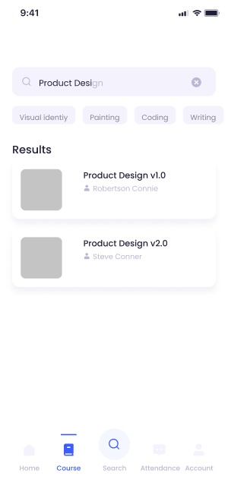
Storyboard/ prototype

Slide 8
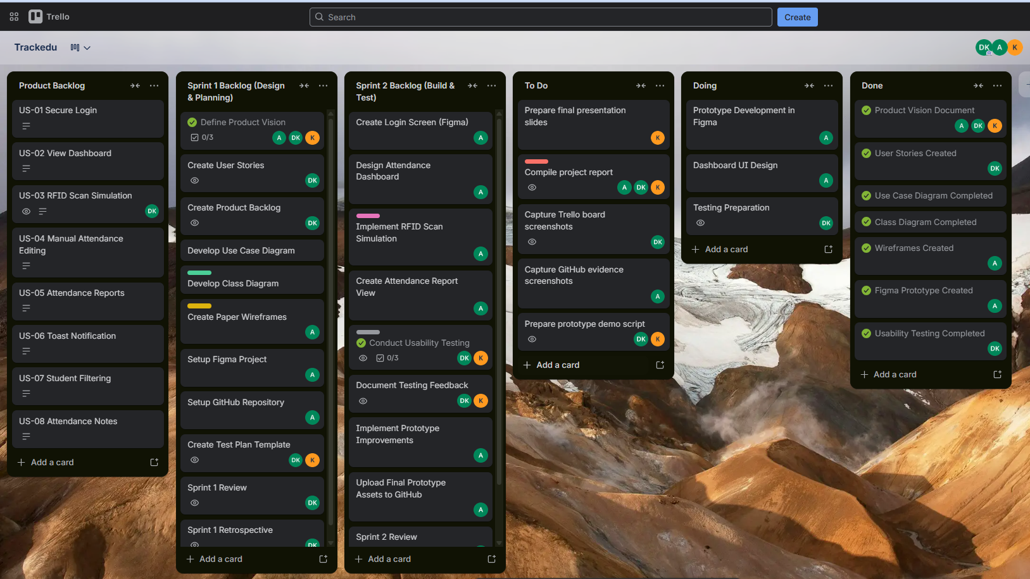
Trello

